Slide 1
Big Data Processing
Jiaul Paik
Lecture 8

Slide 2
Programming on Hadoop Map-reduce Model

Slide 3
Example Problem: Counting Words
Sample application
Result ranking, Language model
How can you solve this using a single machine?
We have a huge collection of text document and count the number of times each distinct word appears in the file

Slide 4
Word Count
Case 1:
Files too large for memory, but all <word, count> pairs fit in memory
You can create a big string array OR you can create a hash table

Slide 5
Word Count
Case 2: All <word, count> pairs do not fit in memory, but fit into disk
A possible approach (write computer programs/functions for each step)
Break the text document into sequence of words
Sort the words
(this will bring the same words together)
3. Count the frequencies in a single pass
This captures the essence of Map-Reduce model
getWords(textFile)
sortWords(list)
countWords(sorted list)

Slide 6
Map-Reduce: In a Nutshell
getWords(dataFile) sort count
Map
extract something you care about (here word and count)
Group by key
(sort and shuffle)
Reduce
Aggregate, summarize
Summary
Structure remains the same
Map and Reduce to be defined by the user to fit the problem

Slide 7
MapReduce: Map Step
Input key-value pairs
(file name and its content)
Intermediate key-value pairs
(word and count)
k1
v1
map
f1
c1
k2
v2
map
f2
c2
k3
v3
…
…
map
k4
v4
f3
c3

Slide 8
MapReduce: Reduce Step
key-value pairs
(produced by Map step)
Output
key-value pairs
Key-value groups
k1
v1
reduce
k1
v1
v3
v6
k1
$$v′$$
k2
v2
Group
by key
reduce
k2
v2
v5
k2
$$v′′$$
k1
v3
…
k3
v4
…
…
k2
v5
k1
v6
k3
v4
reduce
k3
$$v′′′$$

Slide 9
Map-reduce: Word Count
Provided by the programmer
Handled by MR system
Provided by the programmer
MAP:
Read input and produces a set of key-value pairs
Group by key:
Collect all pairs with the same key
Reduce:
Collect all values belonging to the key and output
deep learning architectures such as deep neural networks, deep belief networks,
deep reinforcement learning, recurrent neural networks and
convolutional neural nets have been applied to fields including computer vision
(deep, 1)
(learning, 1)
(architectures, 1)
(such, 1)
(as, 1)
(…., 1)
(….., 1)
(…., 1)
(networks, 1)
(deep, 1)
(reinforcement , 1)
(…., 1)
(and, 1)
….
(vision, 1)
……..
(deep, 1)
(deep, 1)
(networks, 1)
(networks, 1)
(networks, 1)
(the, 1)
(the, 1)
(the, 1)
(reinforcement, 1)
(vision, 1)
…
(deep, 2)
(networks, 3)
(the, 3)
(reinforcement, 1)
(vision, 1)
…
Big document
(key, value)
(key, value)
(key, value)

Slide 10
Word Count Using MapReduce: Pseudocode
map(key, value)
// key: document name; value: text of the document
for each word w in value
emit(w, 1)
reduce(key, values)
// key: a word; value: set of counts values for a word
result = 0
for each count v in values:
result += v
emit(key, result)

Slide 11
Map-Reduce Execution Detailed Look

Slide 12


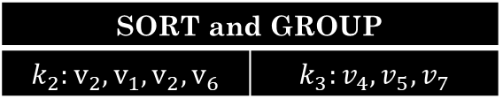
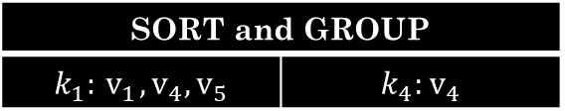

Map-reduce System: Inside Look
map task 1
map task 2
map task 3
data | data | data
data | data | data
data | data | data
M
M
M
M
M
M
M
M
M
($k_{1}, v_{1}$) ($k_{2}, v_{2}$) | ($k_{3}, v_{4}$) | ($k_{4}, v_{4}$)
($k_{2}, v_{1}$) | ($k_{1}, v_{4}$) ($k_{2}, v_{2}$) | ($k_{3}, v_{5}$)
($k_{2}, v_{6}$) | ($k_{3}, v_{7}$) | ($k_{1}, v_{5}$)
partition function
partition function
partition function
All phases are distributed with many tasks running in parallel
SORT and GROUP
$$k_{1}:{ v}_{1},v_{4},v_{5}$$ | $$k_{4}:v_{4}$$
SORT and GROUP
$$k_{2}:v_{2},v_{1},v_{2},v_{6}$$ | $$k_{3}:v_{4},v_{5},v_{7}$$
R
R
R
R
Final output | Final output
Final output | Final output
reduce task 1
reduce task 2

Slide 13
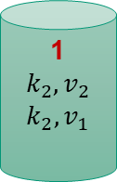
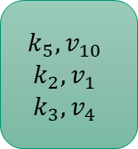
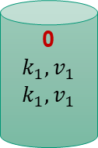
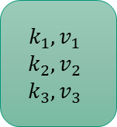
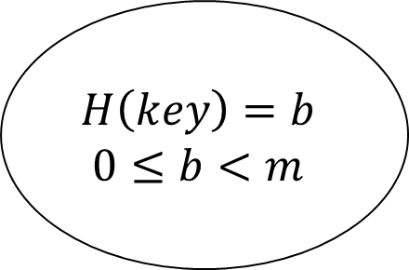
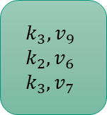
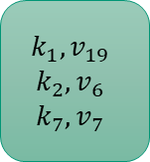
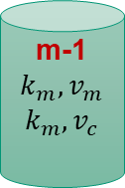
Partitioning
Output files
(partition by keys)
Output from mappers
(on multiple machines)
Partition function
0
$$k_{1},v_{1}$$
$$k_{1},v_{1}$$
$$k_{1},v_{1}$$
$$k_{2},v_{2}$$
$$k_{3},v_{3}$$
1
$$k_{2},v_{2}$$
$$k_{2},v_{1}$$
$$k_{5},v_{10}$$
$$k_{2},v_{1}$$
$$k_{3},v_{4}$$
$$H\left(key\right)=b$$
$$0≤b<m$$
$$k_{1},v_{19}$$
$$k_{2},v_{6}$$
$$k_{7},v_{7}$$
……
m-1
$$k_{m},v_{m}$$
$$k_{m},v_{c}$$
$$k_{3},v_{9}$$
$$k_{2},v_{6}$$
$$k_{3},v_{7}$$

Slide 14
Shuffle and Sort
IMPORTANT and EXPENSIVE OPERATION
MapReduce guarantees input to every reducer is sorted by key
The heart of mapreduce is the shuffle operation
Shuffle does the following
performs the sort
transfers the map outputs to the reducers as inputs

Slide 15
Shuffle and Sort: the map side
partition, sort and
spill to disk
map
merge on disk
Buffer in memory
on local disk
Input data
(chunk)
partitions

